Slide 1
python
Anaconda

Slide 2
https://www.anaconda.com/download/
Windows 64 bit

Slide 3


Slide 4
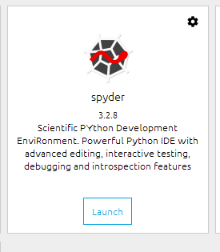

Slide 5
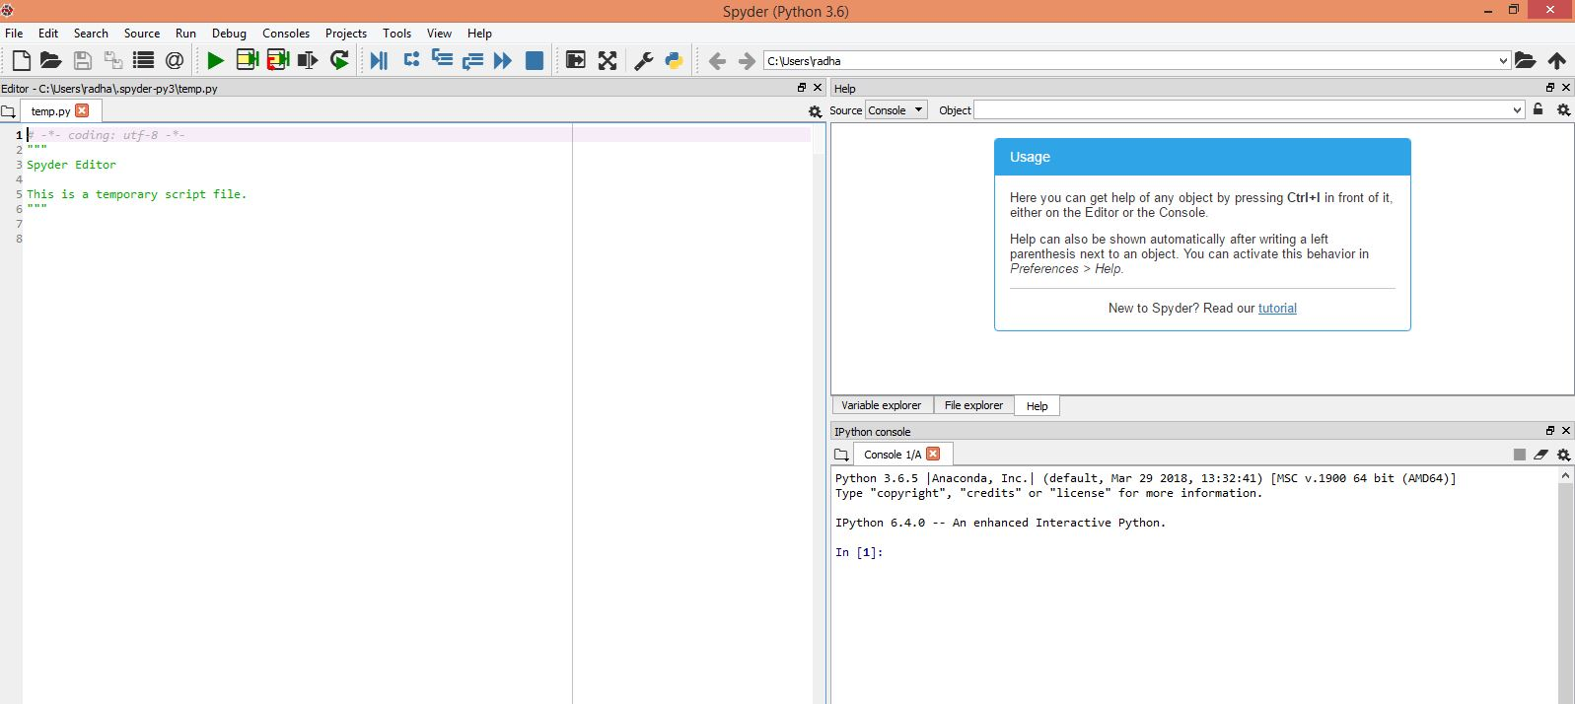

Slide 6
Spyder py path
C:\users\radha\.spyder-py3\
conditions.py # my file
runfile('C:/Users/radha/.spyder-py3/conditions.py', wdir='C:/Users/radha/.spyder-py3')

Slide 7
a = 33
b = 200
if b > a:
print("b is greater than a")

